Slide 1
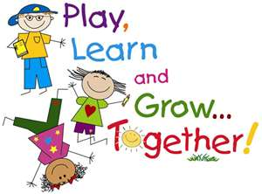
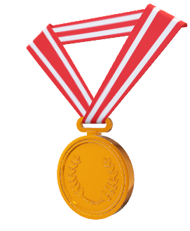
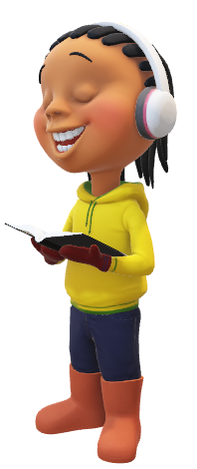
MOST SUCCESSFUL METHODS
KEYS
INTEREST & INVESTIGATIONS
COOPERATIVE
LEARNING
MAIN TECHNIQUES
GROUP RELATIONS, MAINSTREAM AND
SELF-ESTEEM
GROUP STRUCTURE & TEACHERS ROLE

Slide 2

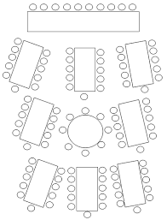


WHAT IS COOPERATIVE
LEARNING?
-Is a pedagogical practice that promotes socialization and learning among students

Slide 3
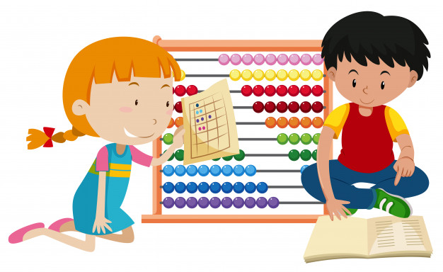
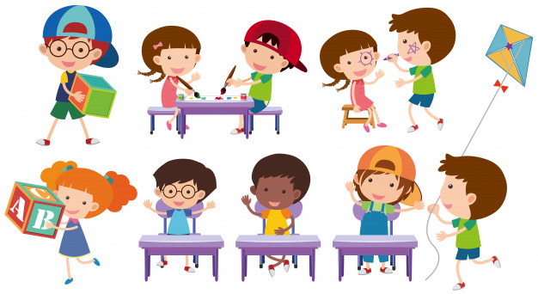
MOST SUCCESSFUL METHODS
-The ones in which groups scores are composed of the sum of individual achievements
-Each member have a unique task for which could be held accountable

Slide 4
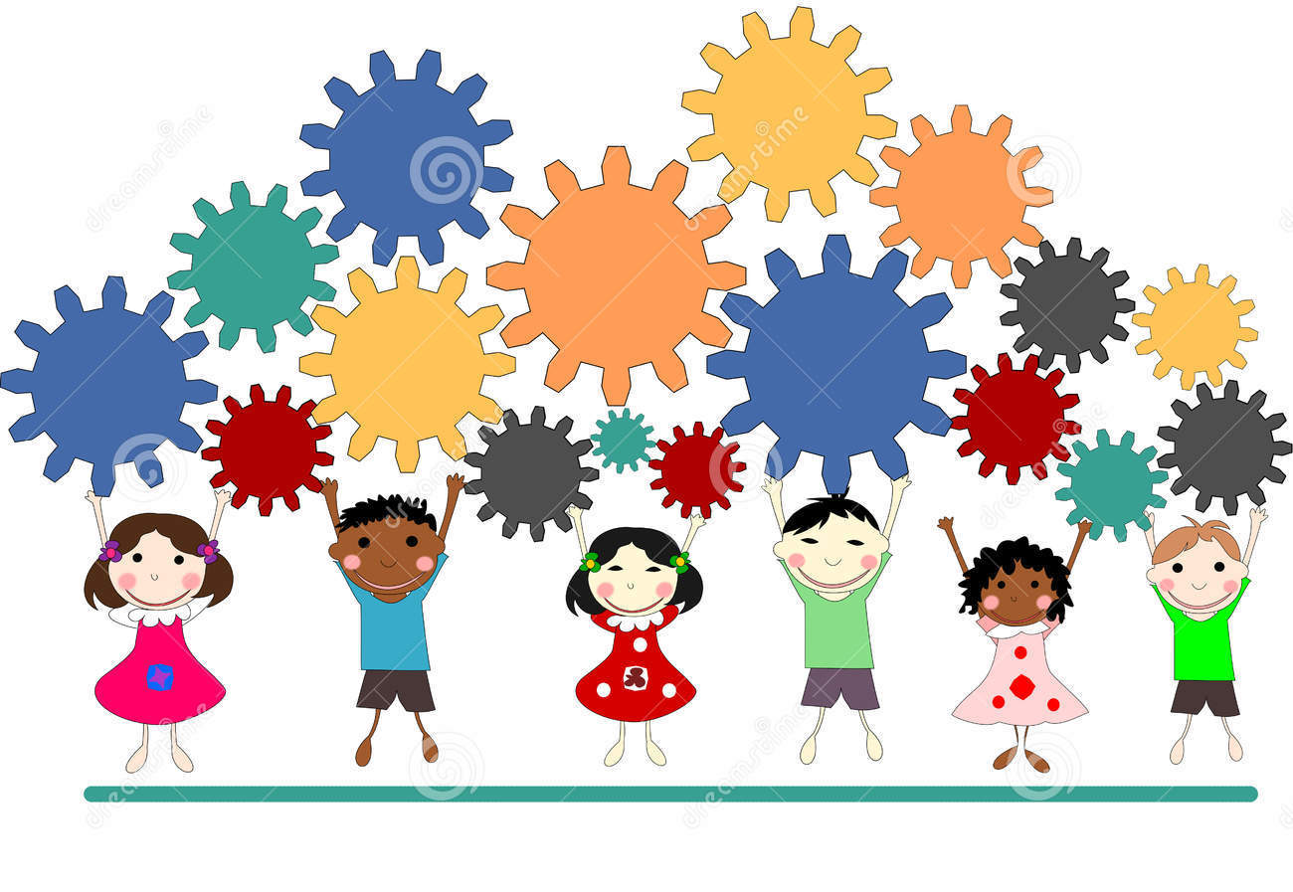
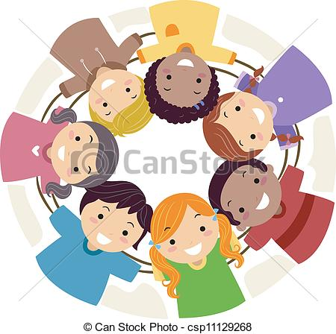
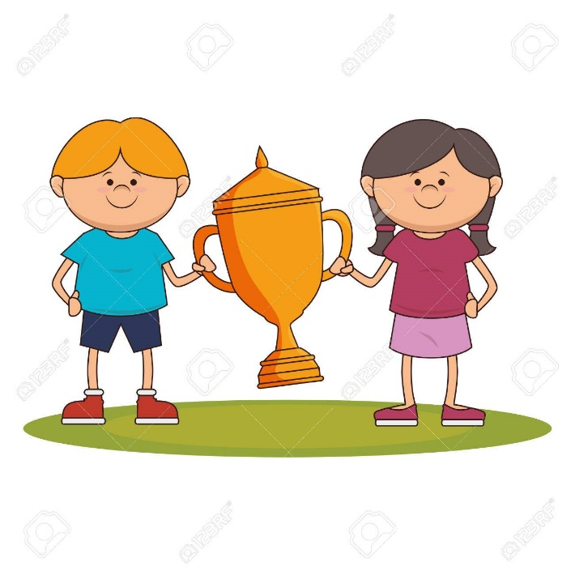
INTEREST AND INVESTIGATIONS
-Studies showed children could be taught to facilitate each learning from others, improve interpersonal attitudes…
-Investigations of teachers and professionals found groups produce a better work when they compete against other groups

Slide 5
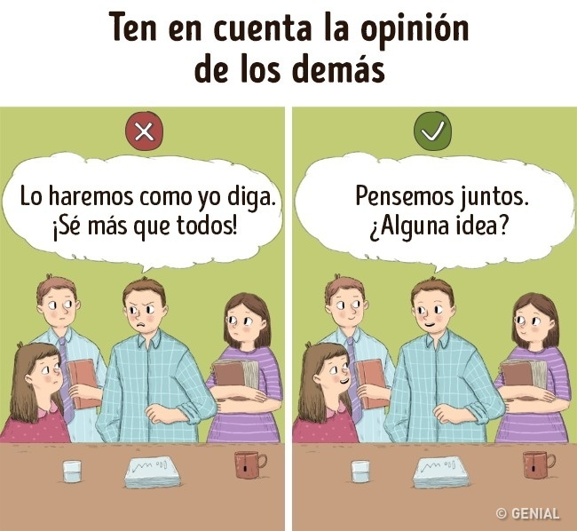
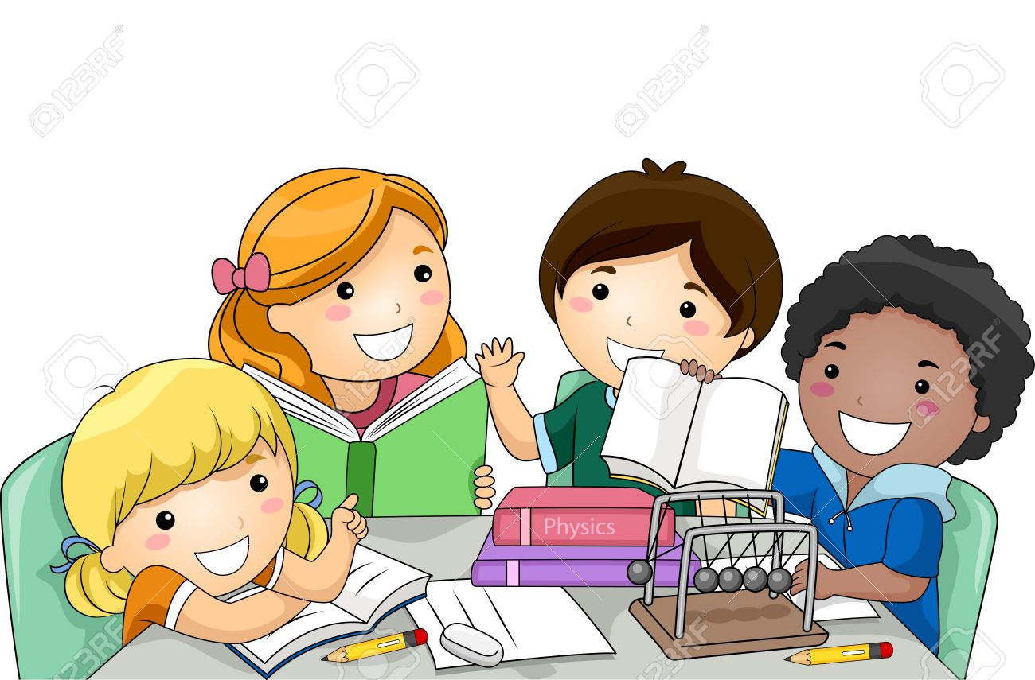
KEYS
-Interaction involves groups members encouraging each other’s efforts, as they work together
-Group members understand they are accountable for they contributions to their group

Slide 6

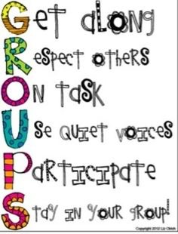
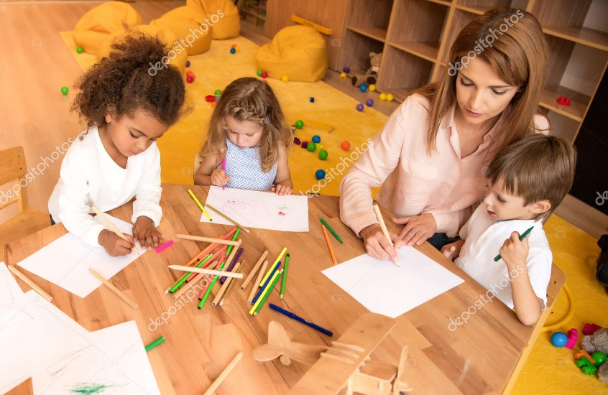
GROUP STRUCTURE & TEACHERS ROLE
Researches found students achieve higher learning when they work in small cooperating groups
(3-4 members) than in bigger (5-7)

Slide 7
GROUP RELATIONS
CL techniques place students of different races in learning groups
MAINSTREAM
Researchers shown CL improves relationships between mainstream and non-mainstream
GROUP RELATIONS, MAINSTREAM AND
SELF-ESTEEM
SELF-ESTEEM
Working together make a very positive help to children who have a lack of good thinking about themselves and also to feel more successful academically

Slide 8

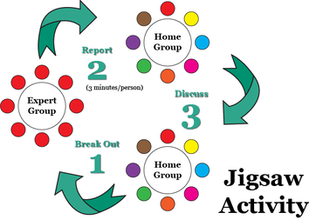
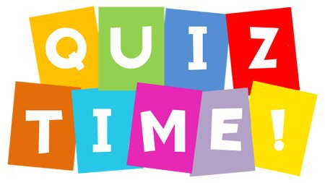
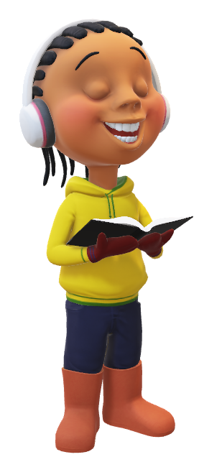
MAIN
TECHNIQUES
TGT
STAD
JIGSAW

