Slide 1

Our ideal school
Alejandra garrido, Irene ramos e Iván corral

Slide 2
PEC
Who we are?→ a public school which want to have an inclusive education.
What we want?→ a real education that involves values and encourage students to be creative and socially active people
How we are going to organize?→ a teachers council and the specific departments of the different subjects. We also want the students to participate actively in the classes and to know their roles. Also we have a pedagogical department to support children who have difficultes on their education process.

Slide 3
Main ideas
A social education
Students participation on educative process
Inclusive school

Slide 4

Social education
-Students will work in groups each one will have one different activity
-Also they will be formed to be socially active
-They will be prepared to real life

Slide 5
Students participation on educative process
We want them to have more responsibilities and to decide their own rules
Students decide what ambient is in class

Slide 6
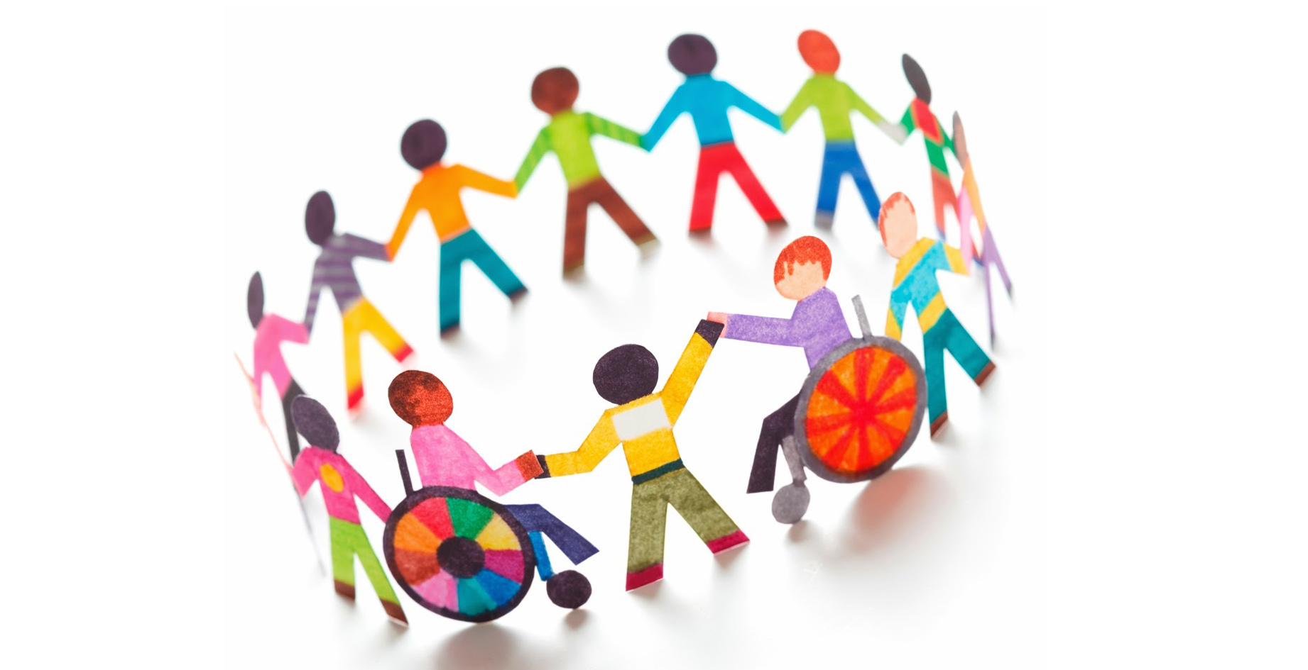
Inclusive school
It is one in which all belong, are accepted and supported by their peers and other members of the school community in the way of getting response to their educational needs.

Slide 7
1.know that all children belong as part of the educational community
2.they emphasize the learning of all students
3.provide equal opportunities for all students
4.they recognize the value of all people
5.they see each person as a unique individual
6.they learn from and about people with diverse characteristics
7.work together in the organization to solve problems
8.share the responsibility of all students

Slide 8
Proposal activities
Real life application→ Classvillage
Students council
Groups of theater.

Slide 9

Classvillage
It consist about a space in the class where the students have a little village, with a supermarket, and a house, (all are fake) so they have to learn how to do the different tasks of the house, and practice in the supermarket´s space with the money.

Slide 10

Students council
We want to create a group of students from differetn ages and classes in order to they can decide a common coexistance rules and the activities that they want to do in the playground, as soccer or basketball leagues. What we want to reach is that the students could have more responsibilities and decisions jut to create a comfortable space where they can learn.

Slide 11
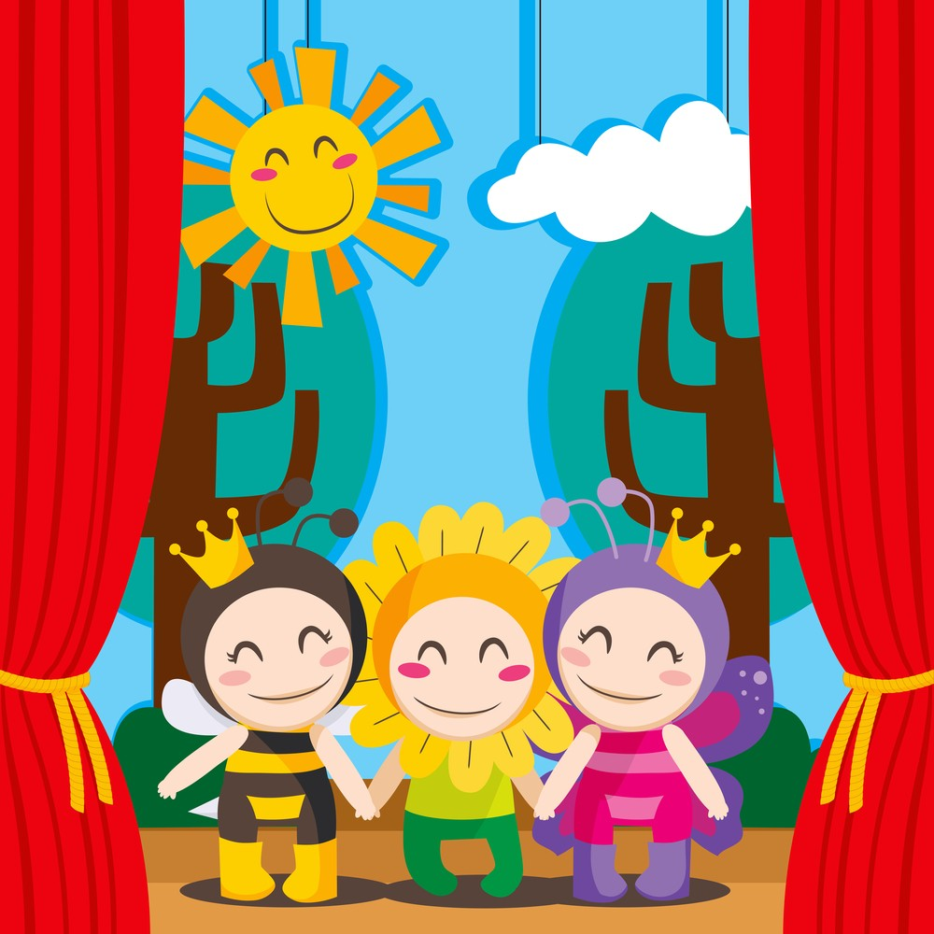
Groups of theater
It will consist in creating an extracurricular activity in which the children can recreate what they have learned in the classes, for example, of history, making a dialogue of characters represented by them, as if it were a theater. This way while learning the contents will be done in a fun and entertaining way

